Slide 1

Energy Consumption Analysis
Presented By:
K.Rohith Reddy

Slide 2
Agenda
Business Problem
Introduction
Problem Statement
Objective of the Project
ER Diagram and schema explanation
Key analysis questions (use cases)
SQL query results with screenshots or summaries
Key Insights
Recommendations
Conclusion
Q&A Slide

Slide 3
Introduction
Business Problem
Economic growth and population increase lead to higher energy consumption.
Higher energy usage often results in increased carbon emissions.
The challenge is to understand the relationship between GDP, population, energy use, and emissions.
The goal is to identify whether countries are growing in a sustainable way.
Energy plays a critical role in the economic and social development of countries. As nations grow in terms of GDP and population, their demand for energy increases, which often leads to higher carbon emissions.
This project analyzes global energy consumption, energy production, GDP, population, and carbon emission data across multiple countries over different years. The aim is to understand how economic growth and population expansion impact energy usage and environmental sustainability.
By studying these relationships, we can identify trends, compare countries, and evaluate whether growth is occurring in a sustainable manner.

Slide 4
Problem Statement:-
The purpose of this project is to study how economic growth and population growth influence energy consumption and carbon emissions across different countries over the years.
The analysis aims to:
Compare energy production and consumption among countries
Identify high-emission countries
Understand trends in emissions over time
Examine whether economic growth is linked to increased pollution

Slide 5
Objective of the Project
To compare energy consumption and production across different countries.
To analyze carbon emission trends over the years.
To study the relationship between GDP growth and energy usage.
To examine how population growth impacts total emissions.
To identify countries with high emissions relative to their economic size.
To evaluate sustainability trends using per-capita analysis.

Slide 6
Database Schema
The database contains six tables: country, emission_3, production, consumption, gdp_3, and population.
The country table acts as the central table, and all other tables are linked to it using foreign keys.
Each country has multiple records across different years, creating one-to-many relationships.
The structure is normalized to maintain data integrity and support efficient time-based analysis.
One-to-Many Relationship
One country → Many emission records
One country → Many production records
One country → Many consumption records
One country → Many GDP records
One country → Many population records

Slide 7
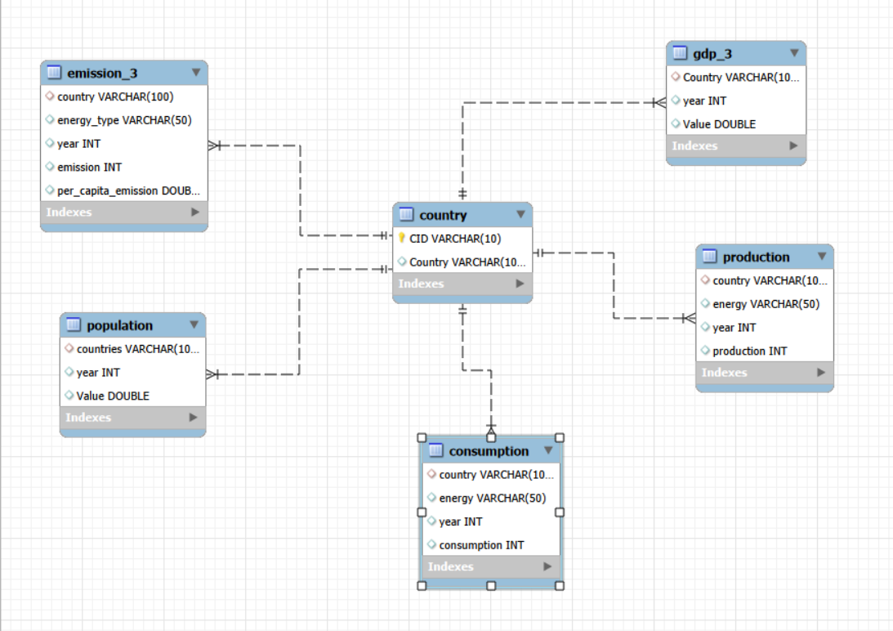
ER Diagram

Slide 8
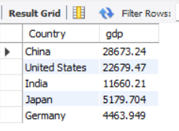
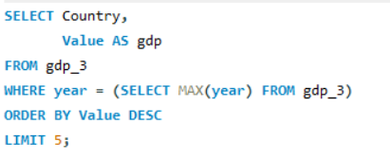
Key analysis questions
1.What are the top 5 countries by GDP in the most recent year?

Slide 9
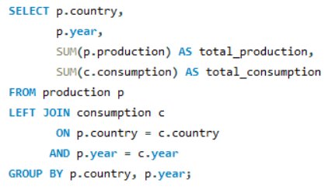
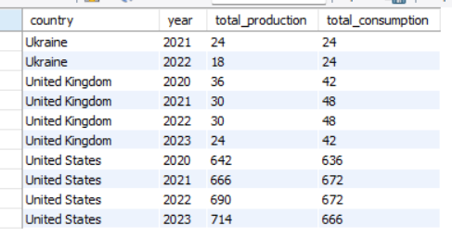
2.Compare energy production and consumption by country and year.?

Slide 10
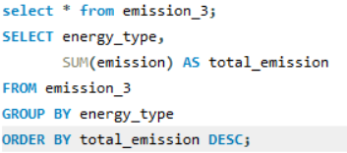
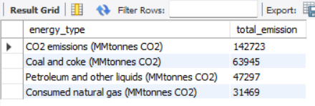
3.Which energy types contribute most to emissions across all countries?

Slide 11
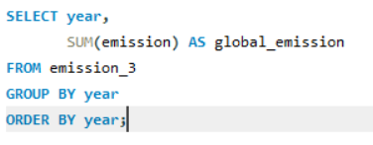
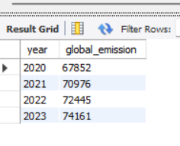
4.How have global emissions changed year over year?

Slide 12
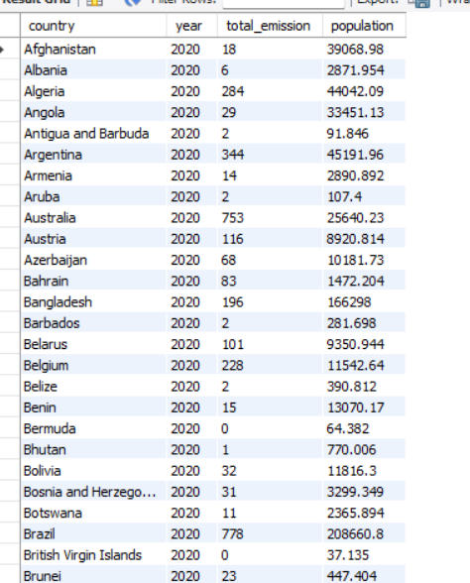
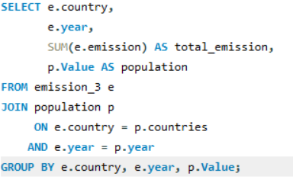
5.How has population growth affected total emissions in each country?

Slide 13
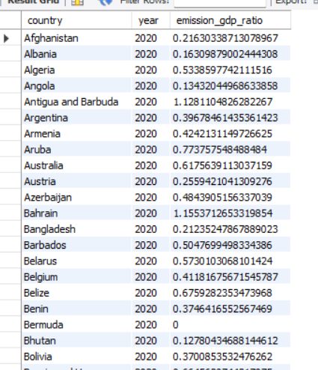
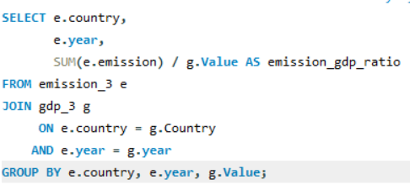
6.What is the emission-to-GDP ratio for each country by year?

Slide 14
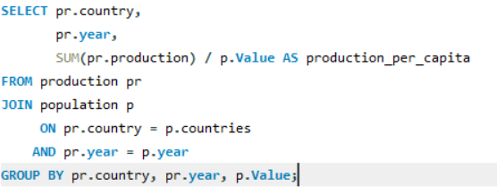
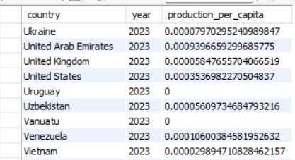
7.How does energy production per capita vary across countries?

Slide 15
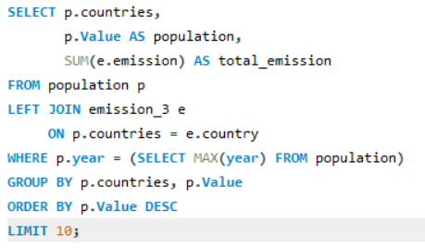
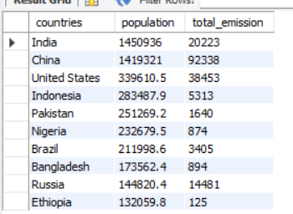
8.What are the top 10 countries by population and how do their emissions compare?

Slide 16
Key Insights
Energy consumption generally increases with GDP growth across major economies.
Countries with large populations contribute significantly to total global emissions.
Per-capita emissions are higher in developed countries compared to developing nations.
Global emissions show an overall upward trend over the years, with minor fluctuations.
Some countries produce more energy than they consume, indicating energy export strength.
Emission-to-GDP ratio varies across countries, showing differences in energy efficiency and sustainability practices.

Slide 17
Recommendations
Increase investment in renewable energy sources such as solar, wind, and hydro to reduce dependence on fossil fuels.
Improve energy efficiency in industries and transportation to lower emissions without slowing economic growth.
Promote policies that reduce the emission-to-GDP ratio through cleaner production technologies.
Encourage energy conservation programs in high-consumption economies.
Support developing countries in adopting sustainable energy infrastructure.
Implement stricter emission regulations for high per-capita emission countries.

Slide 18
Conclusion
This project shows that when a country’s GDP and population increase, its energy consumption also increases. Higher energy use usually leads to higher carbon emissions.
Some countries have very high emissions because they use more fossil fuels. Other countries manage to grow their economy while keeping emissions lower by using cleaner energy and better technology.
Overall, economic growth is important, but it should happen in a way that does not harm the environment. Using renewable energy and improving energy efficiency can help countries grow in a more sustainable way.

Slide 19
Q&A

Slide 20

THANK YOU

